Slide 1
Data Mining DS-303
Lecture 4
Muhammad Arham
Lecturer
The University of Faisalabad

Slide 2
Content
Outlier & Anomaly Detection

Slide 3
Outlier

Slide 4
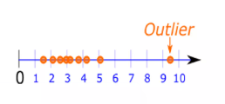
What is an Outlier?
Very often, there exist data objects that do not comply with the general behavior or model of the data. Such data objects, which are grossly different from or inconsistent with the remaining set of data, are called Outliers.

Slide 5
What is Outlier Analysis?
The outliers may be of particular interest, such as in the case of fraud detection, where outliers may indicate fraudulent activity. Thus, outlier detection and analysis is an interesting data mining task, referred to as Outlier mining or outlier analysis.

Slide 6
Statistical Distribution-Based Outlier Detection
Two basic types of procedures for detecting outliers:
Block Procedures: In this case, either all of the suspect objects are treated as outliers or all of them are accepted as consistent.
Consecutive (or Sequential) Procedures: An example of such a procedure is the inside out procedure.

Slide 7
Anomaly

Slide 8

What is Anomaly
Something that deviates from what is standard, normal, or expected.

Slide 9


Slide 10
What is Anomaly Detection?
It is the process of finding patterns in data, that do not conform to a prior expected behavior.
Anomaly detection is an important tool for detecting fraud, network intrusion, and other rare events that may have great significance but are hard to find.

Slide 11
Types of Anomalies
Point Anomaly
In an instance is anomalous compared with the rest of instances, the Anomaly is considered as point anomaly.
Contextual Anomaly
It is specific-context based anomaly. Observation that is unusual in a certain context as a whole.
Collective Anomaly
If a collection of related data instances is anomalous with respect to the entire data set.

Slide 12
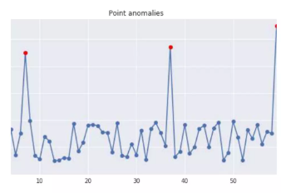
Point Anomaly
Business use case: Detecting credit card fraud based on “Amount Spent”.

Slide 13
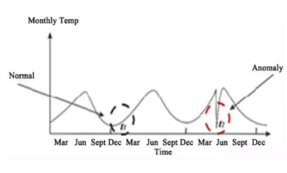
Contextual Anomaly
Business use case: Spending $100 on food everyday during the holiday season is normal, but may be odd otherwise.

Slide 14
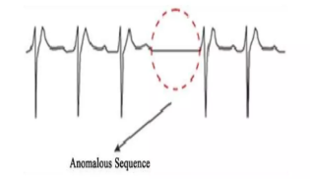
Collective Anomaly
Business use case: Someone is trying to copy data form a remote machine to a local host unexpectedly, an anomaly that would be flagged as a potential cyber attack.
Multiple buy stock transactions and then a sequence of sell transactions around an earnings release date may be anomalous and may indicate insider trading.
Multiple HTTP request from an IP address may indicate a probable web attack.

Slide 15
Applications of Anomaly Detection
Fraud Detection
Fault Detection
System Health Monitoring
Network Intrusion detection

Slide 16
Methodologies to Anomaly Detection
Graphical Approach
Statistical Approach
Machine Learning Approach

Slide 17
Graphical Approach
Graphical Method utilize extreme value analysis, by which outliers correspond to the statistical tails of probability distributions.
Statistical tails are most commonly used for one dimensional distributions, although the same concept can be applied to multidimensional case.
It is important to understand that all extreme values are outliers but the reverse may not be true.
For instance in one dimensional dataset of {1,3,3,3,50,97,97,97,100}, observation 50 equals to mean and isn’t considered as an extreme value, but since this observation is the most isolated point, it should be considered as an outlier.

Slide 18
Box Plot
A standardized way of displaying the variation of data based on the five number summary, which includes minimum, first quartile, median, third quartile, and maximum
This plot does not make any assumptions of the underlying statistical distribution
Any data not included between the minimum and maximum are considered as an outlier
Min ────[ Q1 | Median | Q3 ]──── Max

Slide 19
Scatter Plot
A mathematical diagram, which uses Cartesian coordinates for plotting ordered pairs to show the correlation between typically two random variables. Example: Height vs weight
An outlier is defined as a data point that doesn't seem to fit with the rest of the data points.
In scatterplots, outliers of either intersection or union sets of two variables can be shown. Means A point that is far away from the general pattern or trend

Slide 20
Symbol Plot
This plot plots two dimensional data, using robust Mahalanobis distances (Mahalanobis distance measures the distance between a data point and a distribution (or another point) in multivariate space) based on the minimum covariance determinant(MCD) estimator with adjustment.
Minimum Covariance Determinant (MCD) estimator looks for the subset of h data points whose covariance matrix has the smallest determinant.
Four drawn ellipsoids in the plot show the Mahalanobis distances correspond to 25%, 50%, 75% and adjusted quantiles of the chi- square distribution (The Chi-Square Distribution is a probability distribution used widely in statistics, especially for: Testing hypotheses, Measuring variability).
Notes:
What does MCD do?
It selects a subset of data (say h points)
Chooses the subset with the smallest spread (smallest covariance determinant)
Ignores extreme values while estimating center and spread

Slide 21
Statistical Approach
Hypothesis test (Chi-Square Test, Grubb’s test)
Score

Slide 22
Hypothesis Testing
This method draws conclusions about a sample point by testing whether it comes from the same distribution as the training data.
Statistical tests, such as the t-test and the ANOVA table, can be used on multiple subsets of the data
Here, the level of significance, i.e, the probability of incorrectly rejecting the true null hypothesis, needs to be chosen
To apply this method in R, "outliers" package, which utilizes statistical tests, is used

Slide 23
Chi-Square Test
Chi-square test performs a simple test for detecting outliers of univariate data(one variable) based on Chi-square distribution of squared difference between data and sample mean
In this test, sample variance (calculated from a sample to approximate it) counts as the estimator of the population variance (actual spread of all data (usually unknown))
Chi-square test helps us identify the lowest and highest values, since outliers can exist in both tails of the data.

Slide 24
Grubbs' test
The Grubbs' test statistic is defined as:
Test for outliers for univariate data sets assumed to come from a normally distributed population
Grubbs' test detects one outlier at a time. This outlier is expunged from the dataset and the test is iterated until no outliers are detected
This test is defined for the following hypotheses: HO: There are no outliers in the data set H1: There is exactly one outlier in the data set;
H₀ (Null Hypothesis): No outliers exist
H₁ (Alternative Hypothesis): There is exactly one outlier
Notes:
Grubbs’ test is a statistical method used to detect outliers in univariate data (one variable), assuming the data comes from a Normal Distribution.

Slide 25
Scores
Scores quantifies the tendency of a data point being an outlier by assigning it a score or probability
The most commonly used scores are:
Normal score: x i-Mean standard deviation
T-student score: (z-sqrt n-2) sqrt(z-1-t2)
Chi-square score: x i-Mean sd 2
IQR score: Q3-Q1
By using "score" function in R, p-values can be returned instead of scores.

Slide 26
Machine Learning Approach
Linear Regression
Piecewise/Segmented Regression
Clustering-Based Approaches

Slide 27
Linear Regression
Linear regression investigates the linear relationships between variables and predict one variable based on one or more other variables and it can be formulated as:
Y =B0+ i=1p Bi Xi
where Y and Xi are random variables, ẞi is regression coefficient and ẞ0 is a constant
In this model, ordinary least squares estimator is usually used to minimize the difference between the dependent variable and independent variables.

Slide 28
Piecewise/segmented regression
A method in regression analysis, in which the independent variable is partitioned into intervals to allow multiple linear models to be fitted to data for different ranges
This model can be applied when there are 'breakpoints' and clearly two different linear relationships in the data with a sudden, sharp change in directionality. Below is a simple segmented regression for data with two breakpoints:
Y = CO + 1 X X < X1 Y = C1+ q2 X X > X1
where Y is a predicted value, X is an independent variable, CO and C1 are constant values, p1 and p2 are regression coefficients, and X1 and X2 are breakpoints.

Slide 29
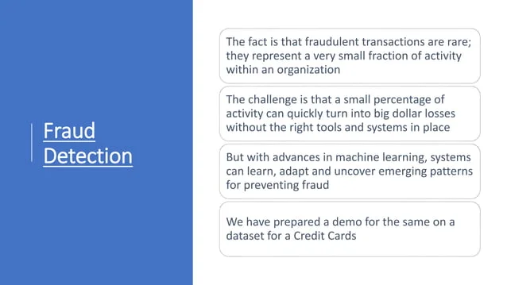

Slide 30
Reference
https://www.slideshare.net/slideshow/outlier-analysis-and-anomaly-detection/88445161
https://www.slideshare.net/slideshow/anomaly-detection-2747825/2747825
https://www.slideshare.net/slideshow/data-mining-outlier-analysis/5005820

Slide 31
Advice
Kindly read the book before and after the lecture, if some terms/ words are not covered in the lecture, if appear in exam it might not appear strange or out of course.

